Slide 1
University admission prediction using machine learning
PROJECT MEMBERS:
SRIVASATAVA SHESHABATTER
HARI PRASAD MORTHALA
RAGHUPAATHI SUDULA
NAGIREDDY REVOORI
KESHAV ELLABOINA

Slide 2
ABSTRACT:
With the increase in the number of graduates who wish to pursue their education, it becomes more challenging to get admission to the students' dream university. Newly graduate students usually are not knowledgeable of the requirements and the procedures of the postgraduate admission and might spent a considerable amount of money to get advice from consultancy organizations to help them identify their admission chances. However, giving the limited number of universities that can be considered by a human consultant, this approach might be bias and inaccurate. Thus, in this paper, a machine learning approach is developed to automatically predict the possibility of postgraduate admission to help graduates recognizing and targeting the universities which are best suitable for their profile. This paper evaluates three learning strategies of regression to predict the university rate given the students' profile; namely, linear regression, decision tree, and logistic regression model. This paper evaluates, these models to select the best model in terms of the highest accuracy rate and the least error. Logistic Regression model shows the most accurate prediction in our experiments, and hence, we suggest employing this model to predict the future applicant's university chance of admission.

Slide 3
INTRODUCTION:
Specific preparation plays a crucial part in your life. Thus education preparation students often have multiple questions about universities which they can get admission and scholarship and accomadation. One of the main concerns is getting admitted to their dream university[1]. It’s seen that students will choose to obtain their education from universities that are known internationally. And when it comes
To international graduates, the United States of America is the preference of majority of them. With most
World-renowned colleges, Wide variety of courses available in each discipline, highly accredited education and teaching programs, students scholarships, are available for international students. According to estimates there are more than one million international students enrolled in over 4200 universities and colleges including both private and public across the united states most of the students studying in America
are from Asian countries like India, Pakistan, Srilanka, Japan etc..
Many colleges in the U.S follow similar requirements for student admission. Colleges take different factors into account, such as the ranking on aptitude assessment and academic record review[3]. The command over the English language is calculated on the basis of their performance in the English Skills test, such as TOEFL and IELTS. The admission committee of universities take the decision to approve or reject a specific Candidate on the basis of the overall profile of the applicant application.

Slide 4
METHODOLOGY
Problem Understanding: Initially first we have to spend some time on are the problems or concerns students
having during their pre admission period and we should set the solutions to those problems as objectives of this research.
Data Understanding: Data should be collected from multiple sources like yocket and also consider all the factors
including which will play a tiny role in student admission process.
Data Preparation: Data should be cleaned that is removing the noise in the data and filling the missing values or extreme values and finalizing the attributes/factors which will have crucial importance in student admission process.
Building Models: several ML models have to be developed using various machine learning algorithms for admission to a particular university and the user interface has to be developed to access those models[6].
Evaluation: Developed models are evaluated according to their accuracy scores. Once the model is finalized that model will be merged with node red for final deployment.

Slide 5
Data cleaning and analysis
 | A | B | C | D | E | F | G | H | I
1 | S.No | GRE scre | TOEfL scre | University | SOP | LOR | CGPA | Rese-arch | COA
2 | 1 | 337 | 118 | 4 | 4.5 | 4.5 | 9.65 | 1 | 0.92
3 | 2 | 324 | 107 | 4 | 4 | 4.5 | 8.87 | 1 | 0.76
4 | 3 | 316 | 104 | 3 | 3 | 3.5 | 8 | 1 | 0.72
5 | 4 | 322 | 110 | 3 | 3.5 | 2.5 | 8.67 | 1 | 0.8
6 | 5 | 314 | 103 | 2 | 2 | 3 | 8.21 | 0 | 0.65
7 | 6 | 330 | 115 | 5 | 4.5 | 3 | 9.34 | 1 | 0.9
8 | 7 | 321 | 109 | 3 | 3 | 4 | 8.2 | 1 | 0.75
9 | 8 | 308 | 101 | 2 | 3 | 4 | 7.9 | 0 | 0.68
10 | 9 | 302 | 102 | 1 | 2 | 1.5 | 8 | 0 | 0.5
11 | 10 | 323 | 108 | 3 | 3.5 | 3 | 8.6 | 0 | 0.45
• Inspecting feature values that help identify what needs to be
done to clean or pre-process until you see the range or
distribution of values typical of each attribute.
• You may find missing or noisy data, or anomalies such as the
incorrect data form used for a column, incorrect measuring
units for a particular column[7], or that there are not enough
examples of a specific class.
• You can know that without machine learning, the problem is
actually solvable.
The data cleaning process has several key benefits to it:
1. This eliminates major errors and inconsistencies which are
unavoidable when dragging multiple data sources into one
dataset.
2. Having data cleaning software will make everyone more
effective as they will be able to get easily from the data what
they need.
3. Fewer mistakes mean happy clients, and less unhappy
workers.
4. The ability to chart the various functions, and what your
data is supposed to do and where it comes from your data.
Fig 1:-Admission Prediction csv data

Slide 6
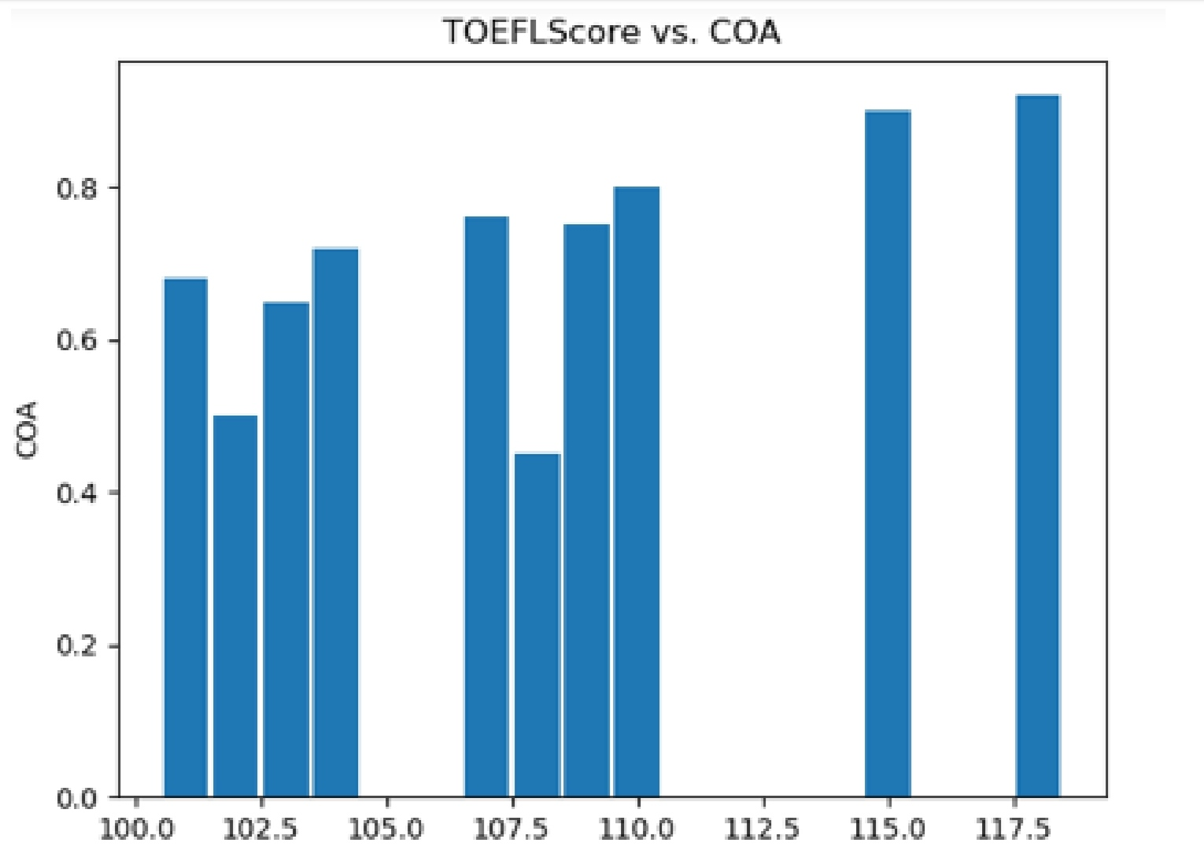
Data visualization
• After analysing the data, we will be able to know what the
features and labels are, so from the above data, the label we
have to consider is Chance of Admission[8] and then we have
to consider the parameters that influence or play a major role
in Chance of Admission
• We can get to know certain features that are more affected
by the visualization (or) analysis or the use of feature
importance method in decision tree
• Below are some of our data visualizations[9]
Fig 2:-TOEFL vs COA(Chance Of Admit)
As we can see from above ,students with strong TOEFL score have high chances of being admitted.

Slide 7
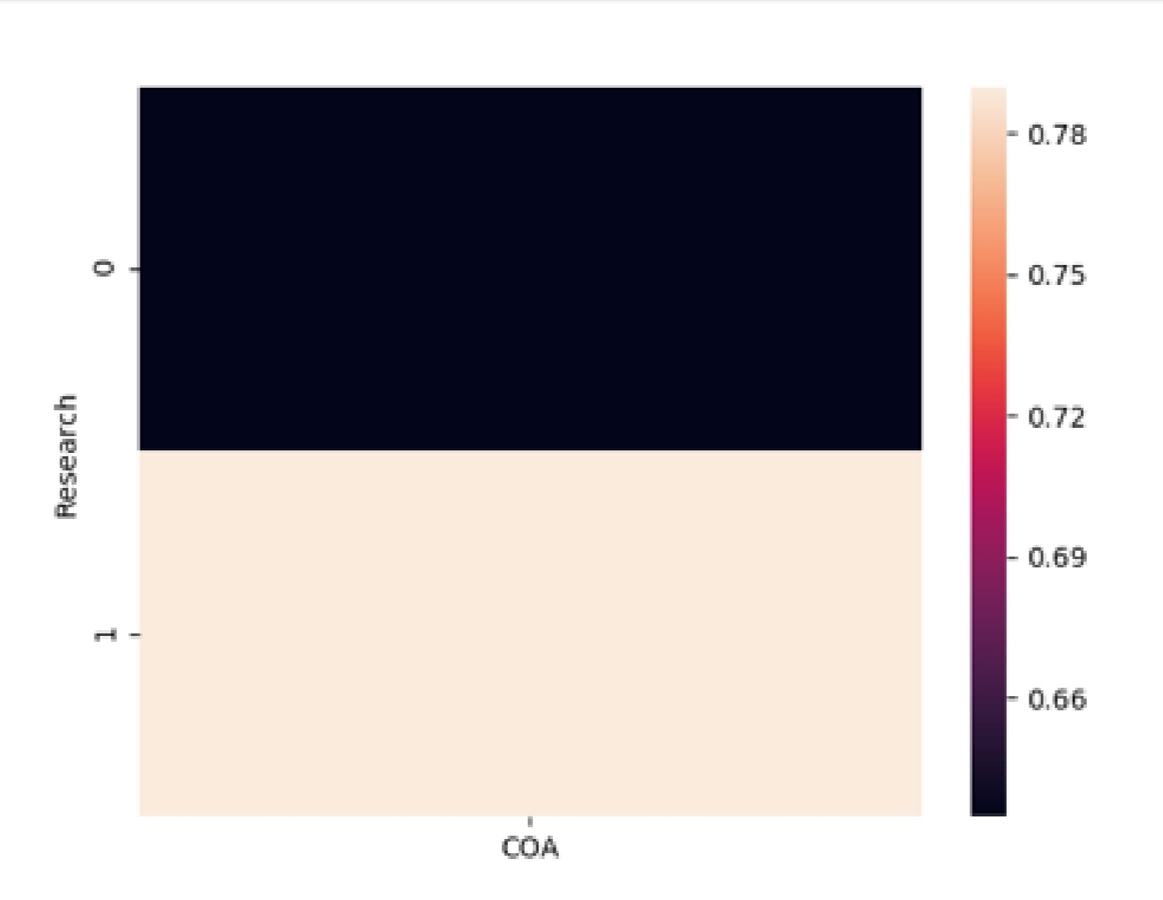
As we see from the image,
Students who have had a high chance of accepting work
Fig 3:-Research vs Chance of Admit

Slide 8
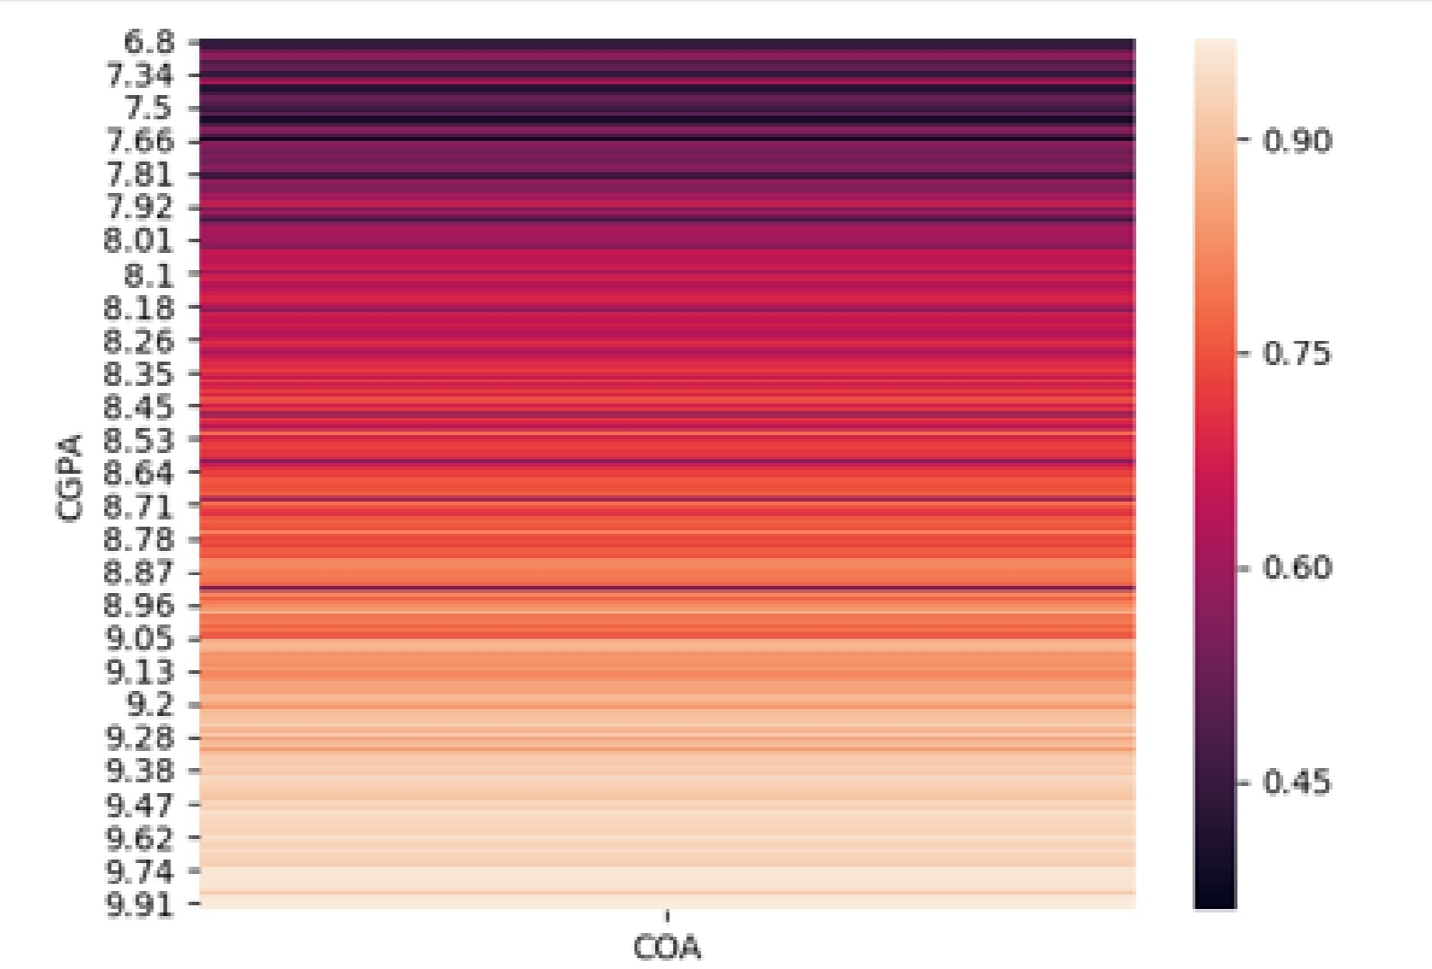
As we can see from the figure 4,
Students with strong CGPA are very likely to admit
Fig 4:-CGPA vs Chance Of Admit

Slide 9
Algorithm
LOGISTIC REGRESSION:
Logistic regression is a supervised learning classification algorithm used to predict the probability of a target variable. The nature of target or dependent variable is dichotomous, which means there would be only two possible classes.
In simple words, the dependent variable is binary in nature having data coded as either 1 (stands for success/yes) or 0 (stands for failure/no).
Mathematically, a logistic regression model predicts P(Y=1) as a function of X. It is one of the simplest ML algorithms that can be used for various classification problems such as spam detection, Diabetes prediction, cancer detection etc.

Slide 10
TYPES OF LOGISTIC REGRESSION:
Generally, logistic regression means binary logistic regression having binary target variables, but there can be two more categories of target variables that can be predicted by it. Based on those number of categories, Logistic regression can be divided into following types −
Binary or Binomial
In such a kind of classification, a dependent variable will have only two possible types either 1 and 0. For example, these variables may represent success or failure, yes or no, win or loss etc.
Multinomial
In such a kind of classification, dependent variable can have 3 or more possible unordered types or the types having no quantitative significance. For example, these variables may represent “Type A” or “Type B” or “Type C”.
Ordinal
In such a kind of classification, dependent variable can have 3 or more possible ordered types or the types having a quantitative significance. For example, these variables may represent “poor” or “good”, “very good”, “Excellent” and each category can have the scores like 0,1,2,3.

Slide 11
FLOW CHART
KNOWN TARGET VALUES
LEARNING ALGORITHM
TRAINING DATA
FEATURE REPRESENTATION
FEATURE REPRESENTATION
LEARNING MODEL
PREDICTED TARGET VALUE
UNSEEN DATA

Slide 12
Advantages:
1.Logistic regression is easier to implement, interpret, and very efficient to train.
2.It is very fast at classifying unknown records.
3.It can interpret model coefficients as indicators of feature importance.
4.Good accuracy for many simple data sets and it performs well when the dataset is linearly separable.
Disadvantages:
1.It construct linear boundaries.
2.If the number of observations is lesser than the number of features, Logistic Regression
should not be used, otherwise it may leads to overfitting.
3.Non-linear problems can’t be solved with logistic regression because it has a linear
decision surface.

Slide 13
Applications:
Logistic regression is used in various fields, including machine learning, most medical fields, and social sciences.
Medical researchers want to know how exercise and weight impact the probability of having a heart attack. To understand the relationship between the predictor variables and the probability of having a heart attack, researchers can perform logistic regression.
business wants to know whether word count and country of origin impact the probability that an email is spam. To understand the relationship between these two predictor variables and the probability of an email being spam, researchers can perform logistic regression.
Logistic regression can be also used in Hotel Booking, Text Editing, Gaming etc.,

Slide 14
CONCLUSION:
The main goal of this work is to create machine learning model for predicting.
Whether students can continue their higher education in their dream college
or Not.
This model uses LOGISTIC regression for predicting the outcome. Our model
predicts the outcome .
Our model predicts the outcome based on the marks entered by the students
in web based application.
The goal of this model is accomplished by predicting the outcomes with an
accuracy of 90 percent and saving time of students.

